Slide 1
Why 2-D Lookup?
VLOOKUP() with MATCH()

Slide 2
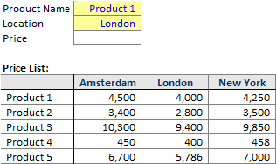
Situation that needs 2-D Lookup

Slide 3
Option 1: Complex Nested IFs

Slide 4


Option 2: VLOOKUP + MATCH
finds the position no.

Slide 5
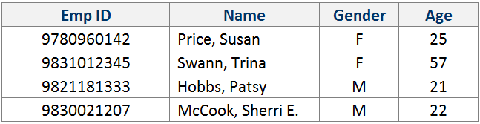
The chemistry…
VLOOKUP() aka Senior
MATCH() aka Junior

Slide 6
Why 2-D Lookup?
VLOOKUP() with MATCH()

